Slide 1

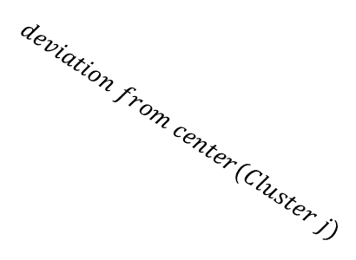



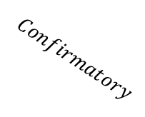
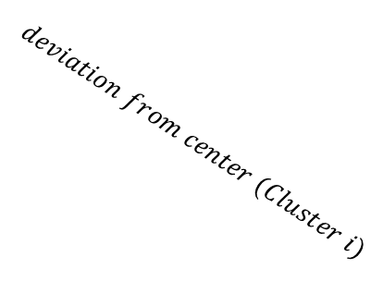
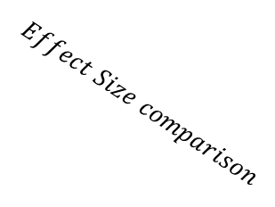
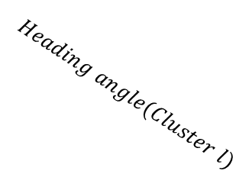
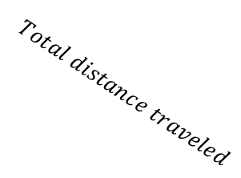
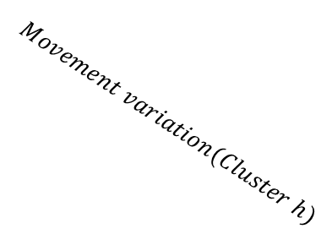

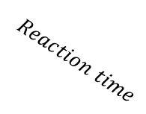
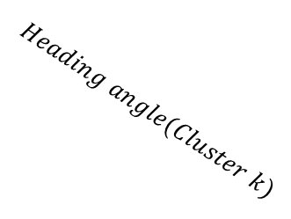
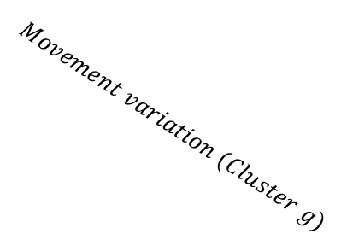


With time series variables
$$Effect Size comparison$$
$$Reach$$
$$Keyboard$$
$$Exploratory$$
$$Confirmatory$$
$$Reaction time$$
$$Movement time$$
$$COM$$
$$Total distance traveled$$
$$Reach area$$
$$RT$$
$$deviation from center (Cluster i)$$
$$deviation from center(Cluster j)$$
$$Movement variation (Cluster g)$$
$$Movement variation(Cluster h)$$
$$Heading angle(Cluster k)$$
$$Heading angle(Cluster l)$$
Permutation + Clustering
Deviation
from center
i
j
Proportion of Z traveled

Slide 2
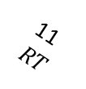

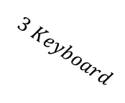

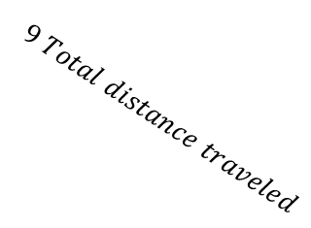
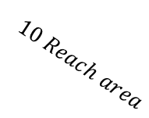

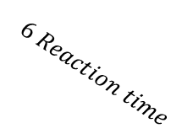

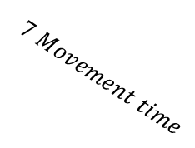
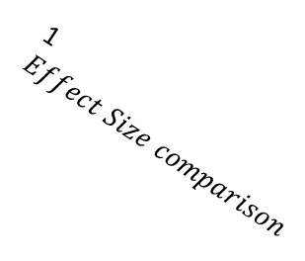
1 $Effect Size comparison$
W/o time series variables
$$2 Reach$$
$$3 Keyboard$$
$$4 Exploratory$$
$$5 Confirmatory$$
11 $RT$
$$6 Reaction time$$
$$7 Movement time$$
$$8 COM$$
$$9 Total distance traveled$$
$$10 Reach area$$

